Slide 1
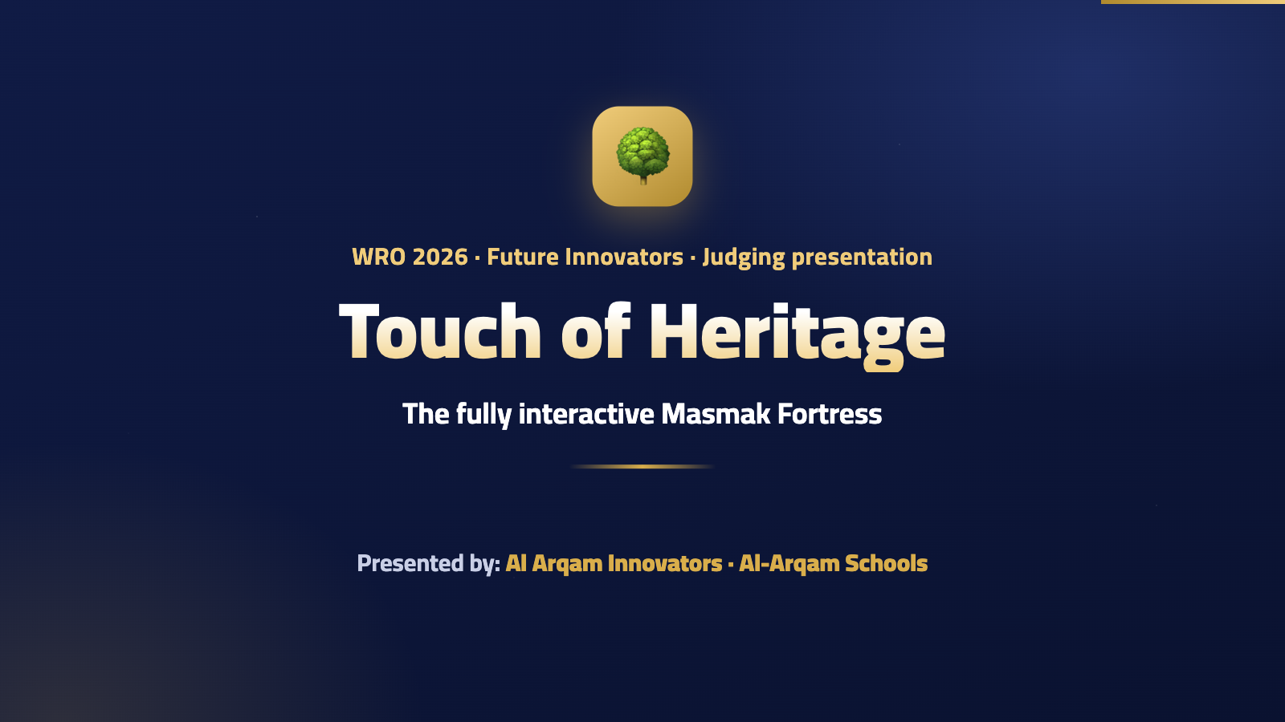
Notes:
The narrator starts by itself: a welcome and the project name.

Slide 2
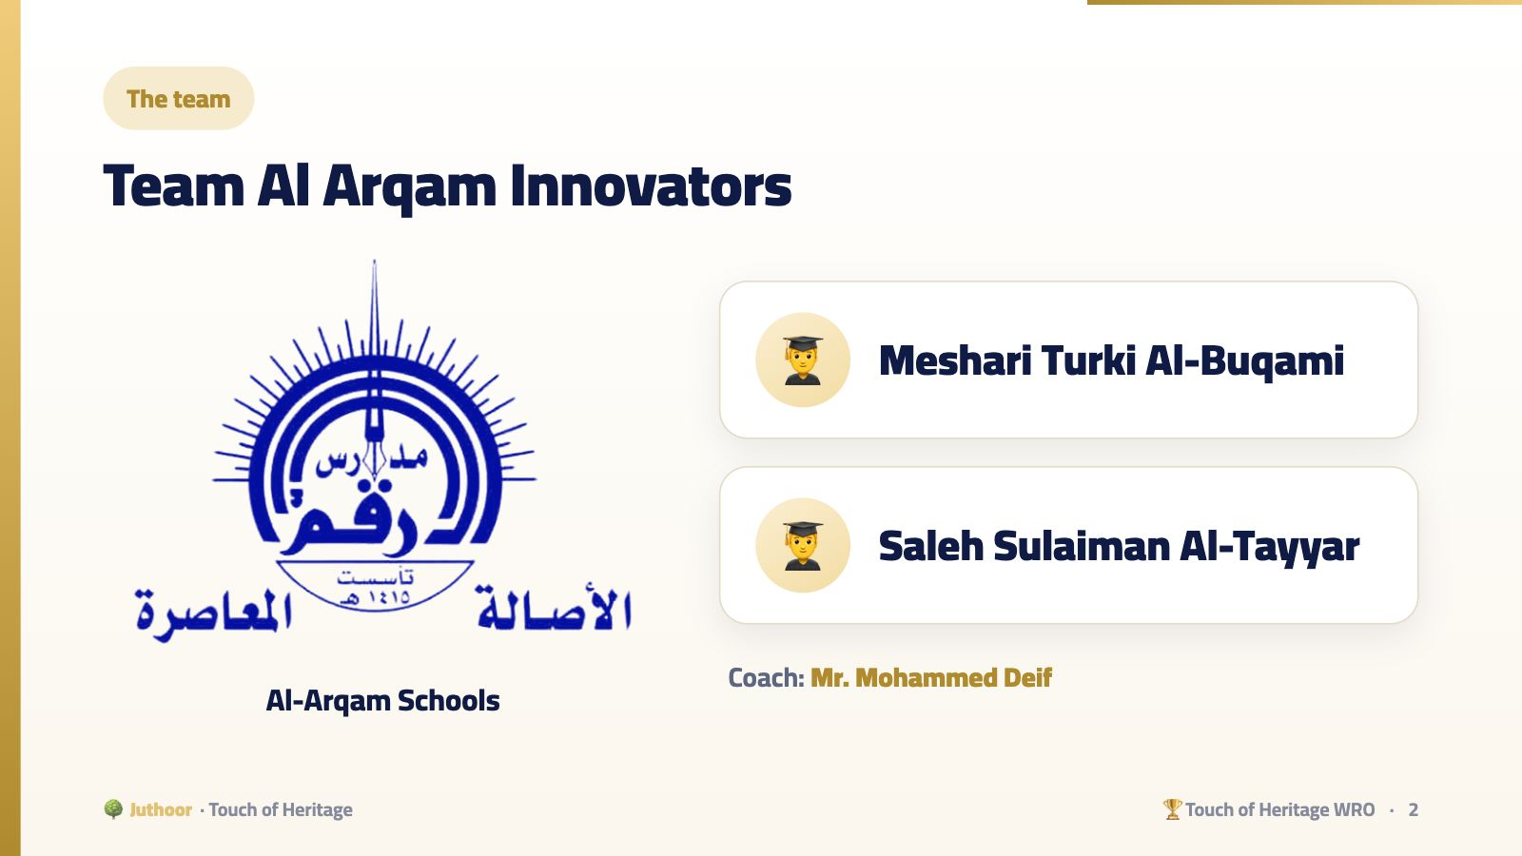
Notes:
Each student introduces himself in one sentence: his name and the part of the project he built.

Slide 3
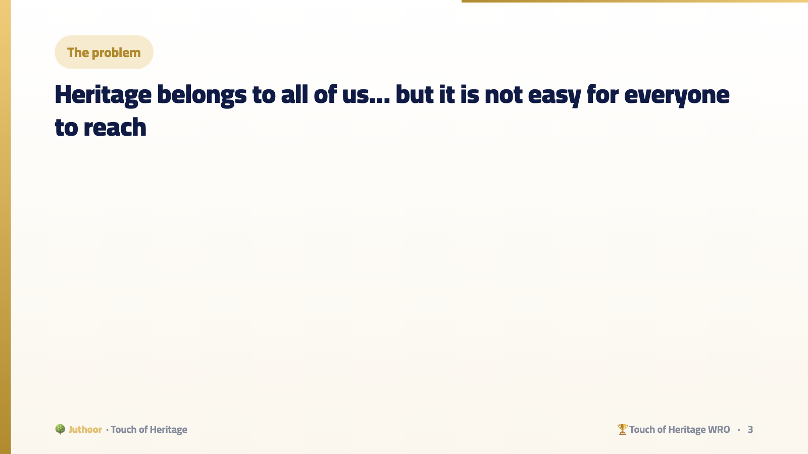
Notes:
Through field visits and talking with people with disabilities, the team noticed that heritage sites are rarely designed for everyone. The need is not three separate solutions, but one smart solution.

Slide 4
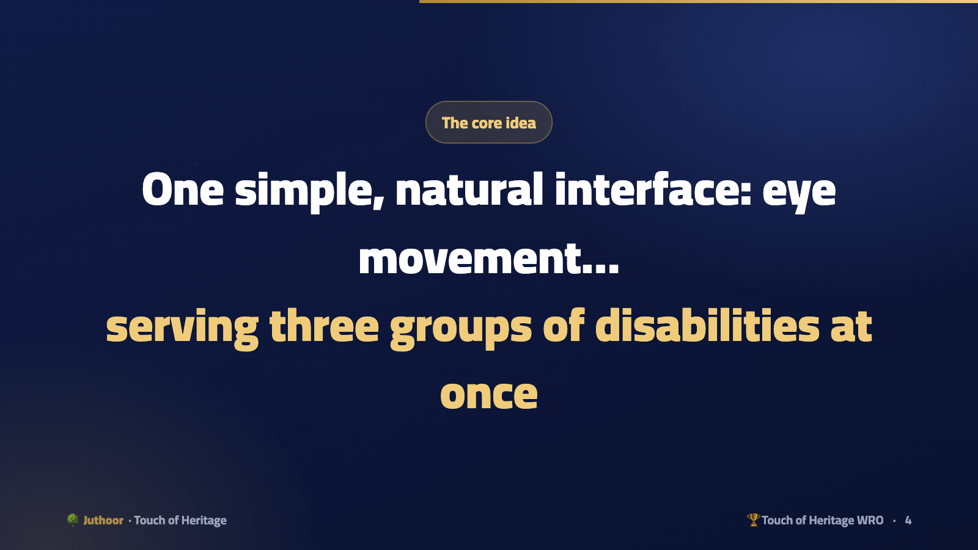
Notes:
Motor: no buttons needing strength or precision. Hearing: a sign-language video. Visual: audio narration. This unified design is what sets the project apart from solutions that treat each disability separately.

Slide 5
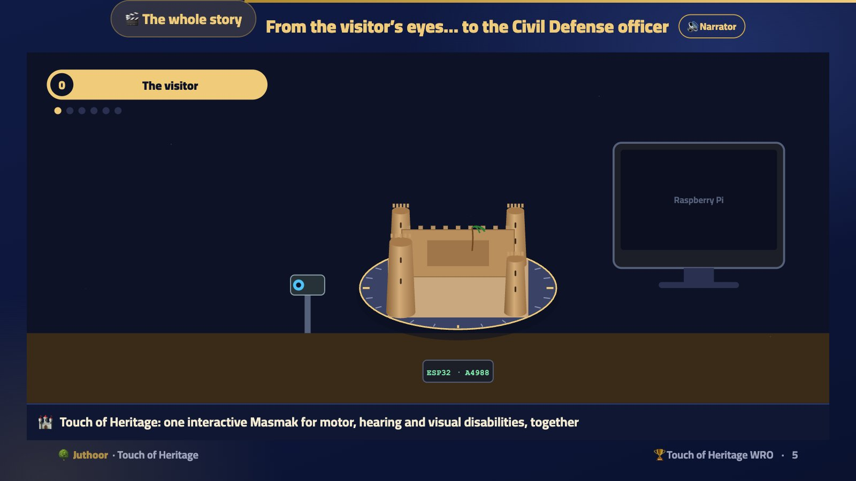
Notes:
Plays first in front of the judges, with the English narrator (in PowerPoint it is a video that starts by itself; on the web press 🔊 Narrator). Chapter 0: the visitor in the LEGO wheelchair, the camera welcomes him, his eyes turn the fortress right and left with the light wave, he holds his gaze and gets sign language + audio narration together, and a blink or the watchdog stops the turntable. Then the safety station: (1) fire only: the leader puts it out and backs up. (2) gas only: the leader gives robot 2 permission. (3) fire and gas: leader to the fire, robot 2 to the gas + Telegram. (4) a fire too big: “we need help”, and the Civil Defense officer leads robots 3 and 4 by hand until “the museum is safe”. Let it run completely, then start explaining.
🎬 فيديو بصوت الراوي يبدأ وحده عند فتح الشريحة.

Slide 6
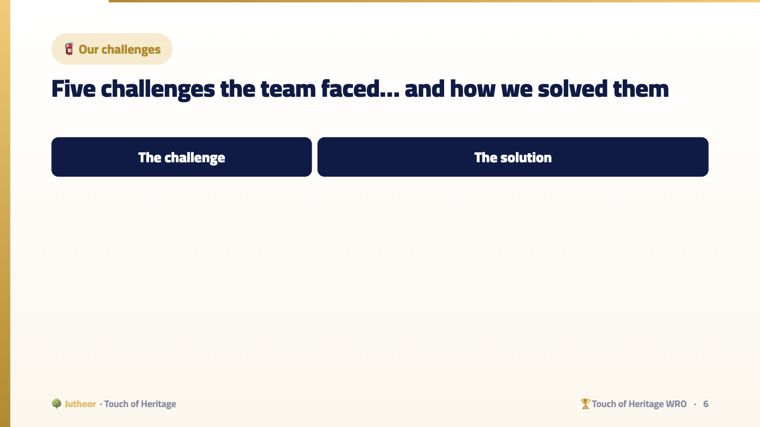
Notes:
Judges love this table more than a feature list: it shows the team really built, made mistakes, understood, and fixed them.

Slide 7
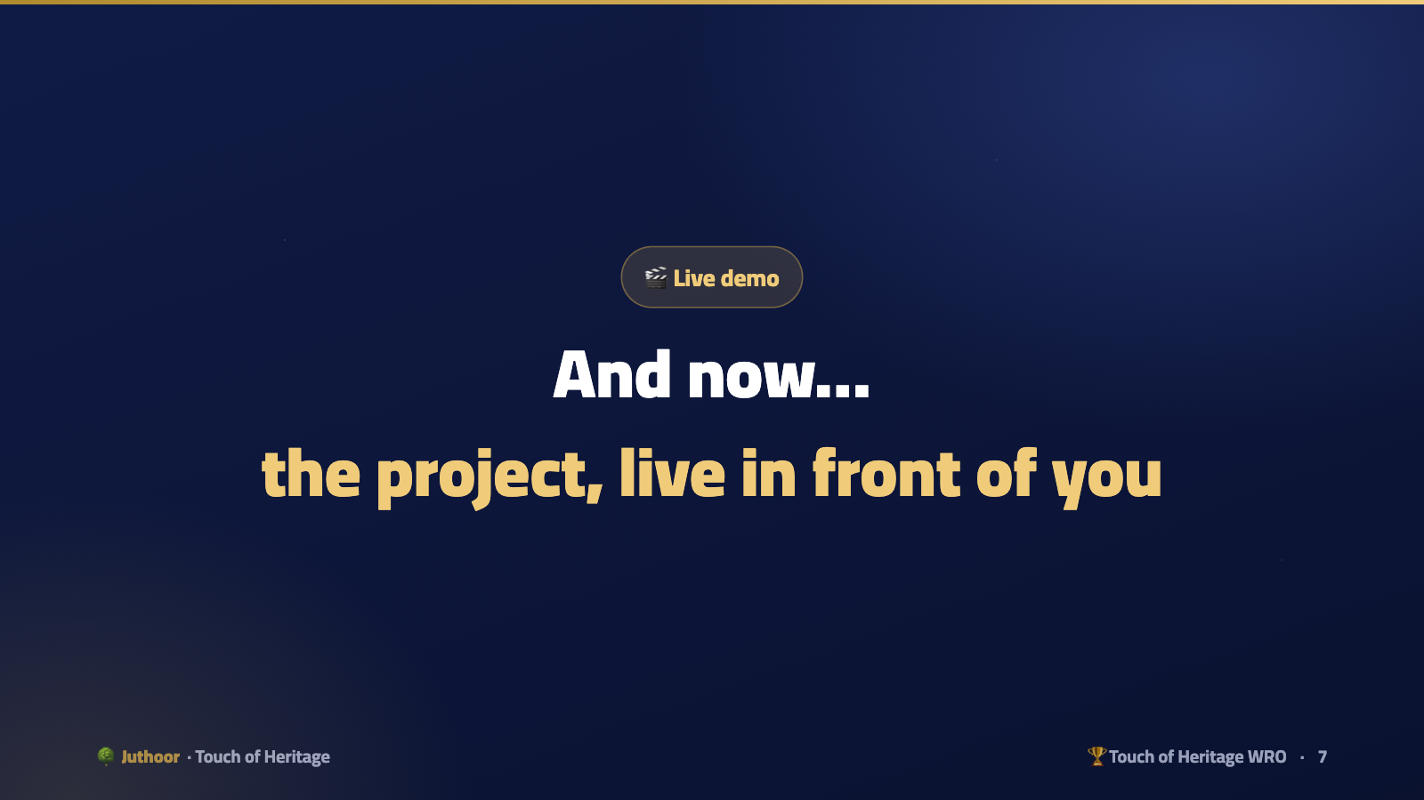
Notes:
After this slide the students run the project in front of the judges without explaining: the explanation came before.

